Slide 1
pyATS Automated Network Tests
April 2021

Slide 2
Agenda
What is pyATS
What can pyATS test cases can do
What makes up a pyATS Network Test Project
Demo

Slide 3

Notes:
What is Version Control?
And What does it provide?

Slide 4

Notes:
Secure – Uses HTTPS and SSH as transport mechanism, data at rest is encrypted.
Free – Git is open-source and it is free to use. The remote component is a SaaS based service which we will look at in the next slides.
Flexible - provides flexibility in terms of branching code, merging code which allows for more than one person working on the same piece of code.
Provides conflict resolution aswell.

Slide 5
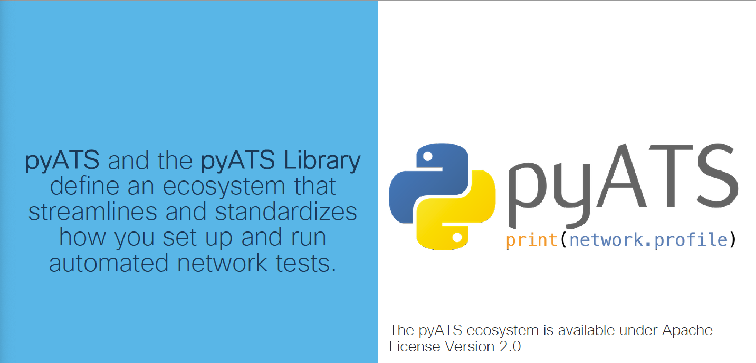

Slide 6
What can pyATS test cases do?
Are all devices reachable?
Are interfaces in my device Up?
Are there any input/output or crc errors on my Interfaces?
Are all my BGP neighbors established?
Do my routers have a particular route?
Much more…

Slide 7
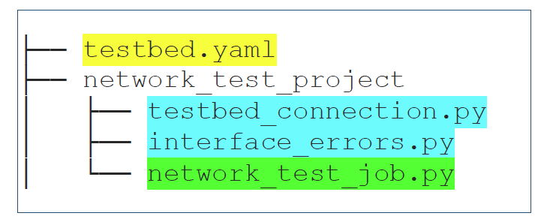
What makes up a pyATS Network test Project
Testbed
YAML file
Describes network topology
AEtest Testscripts (Automation Easy Testing)
One or more Python files.
Define setup, execution and cleanup of tests
Easypy Jobfiles
Python file
Combines testscripts and defines runtime, logging and archives

Slide 8
Demo

Slide 9
